Slide 1
Immersive
Real world
Hands-on
Experiential
Experience
Confidence
Managing
Entrepreneurship
The Game
Quarter x Results
Responsibility
Sandbox
Responsibility

Slide 2
Entrepreneurship – The Game
Due Diligence
Marketing
Cash Flow & HR
Product & Markets
Review
Process
Quarterly Process

Slide 3
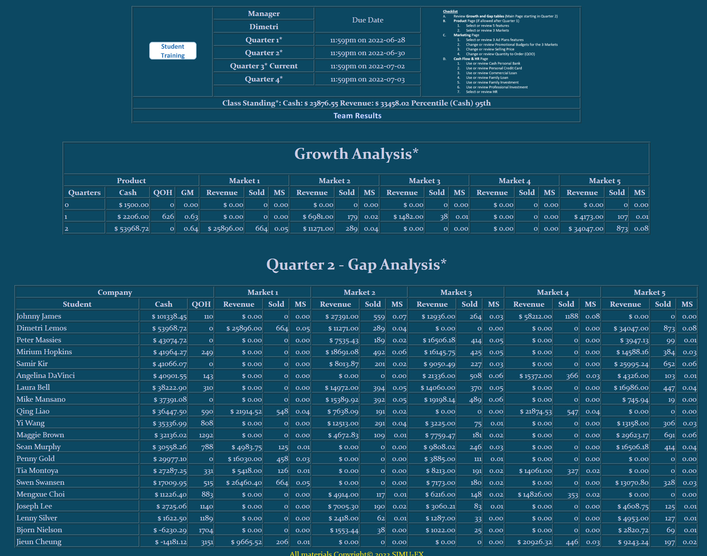
❶Milestones
Your Quarterly Results
Cash in Bank
QOH
GM
Revenue in Markets
Units Sold in Markets
Market Share
Growth?
Growth Table
❷Growth
❸Gap
Quarter 2, 3 and 4
QOH
Revenue in Markets
Units Sold in Markets
Market Share
Cash Analysis
Gap Analysis
Gap Table
Due Diligence

Slide 4
Monitor - Manage
M&M
❹Class Benchmarks
Benchmarks

Slide 5
Monitor - Manage
❺Gross Margin
M&M
Measures & Metrics
M&M
❻Value Proposition
Managing

Slide 6
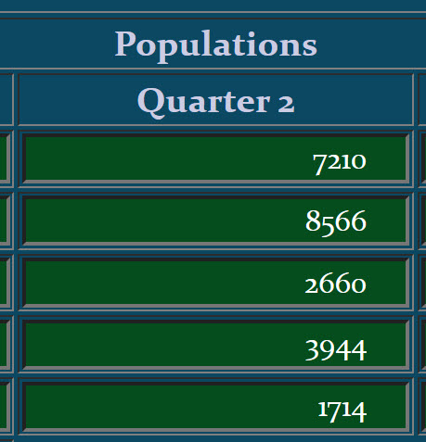
Monitor - Manage
❼QOH-Inventory
M&M
Measures & Metrics
M&M
❽Forecast & Markets
Managing

Slide 7
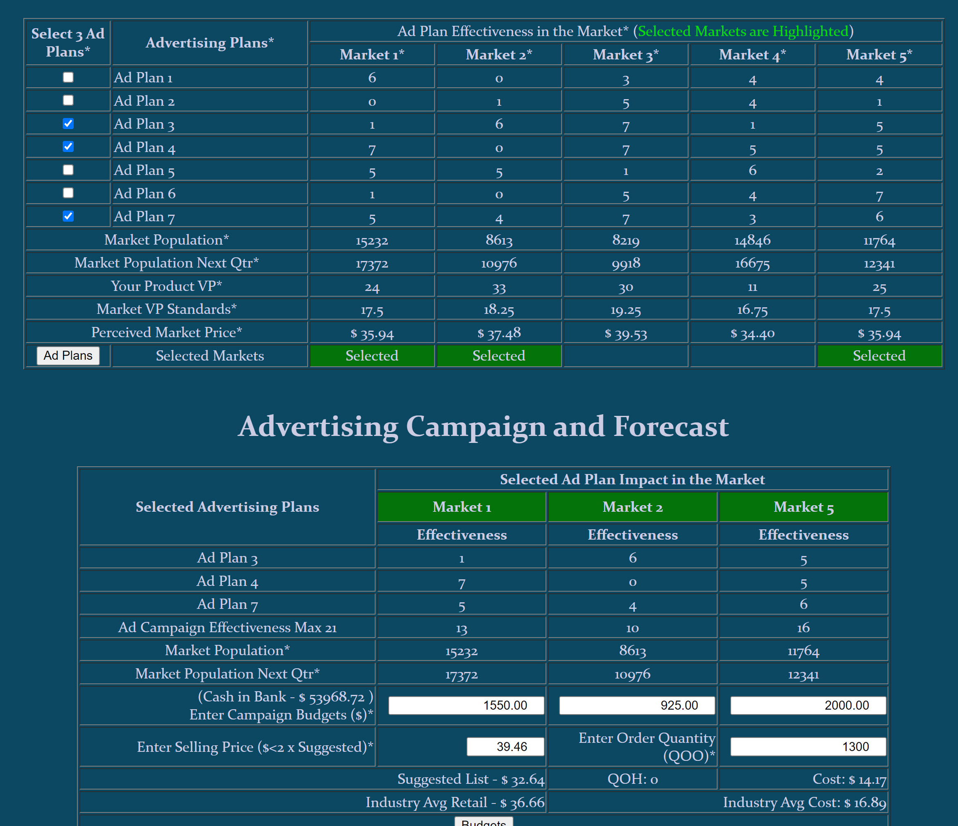
Monitor - Manage
M&M
3 Ad Plans
Measures & Metrics
M&M
❾Promotional $
⬥ Retail Price
⬥ Promotional Budgets
❿Pricing
⬥ Quantity of Product to order
Managing

Slide 8
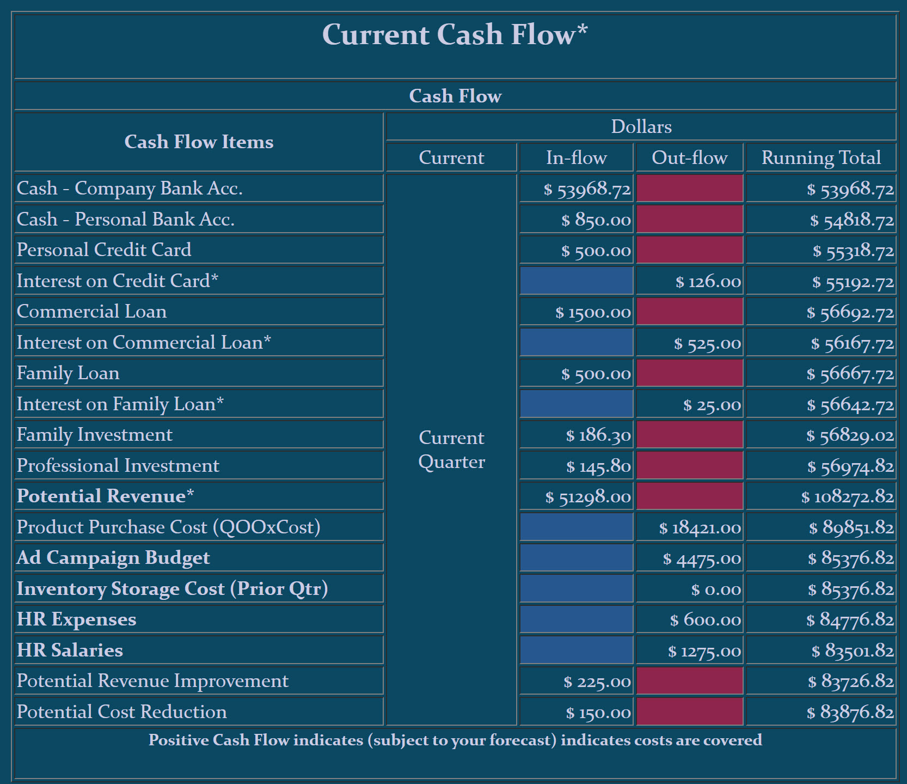
Monitor - Manage
Sources of Funds
M&M
Then Manage Cash in Bank
 HR Expense
Stock Sales
Managing

Slide 9
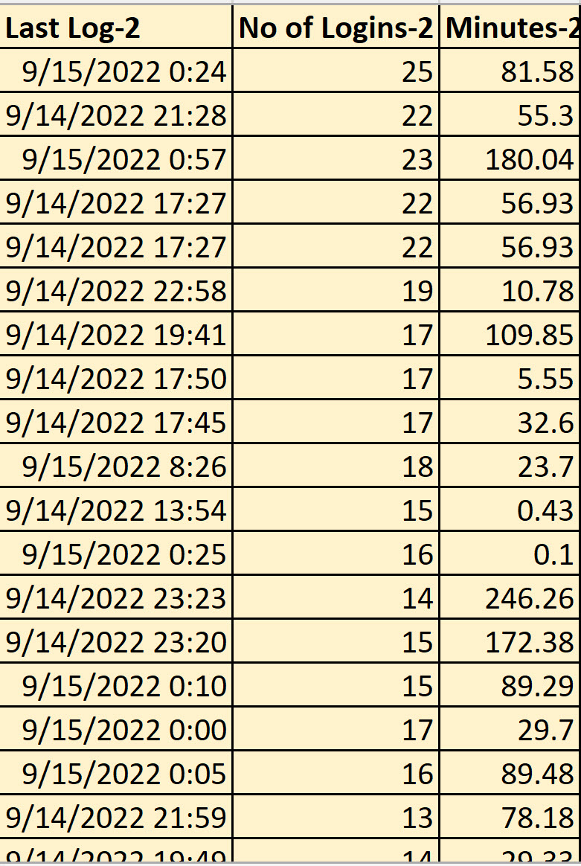
Activity Measures
Monitor - Manage
M&M
Measures & Metrics
M&M
Faculty Measures and Metrics

Slide 10
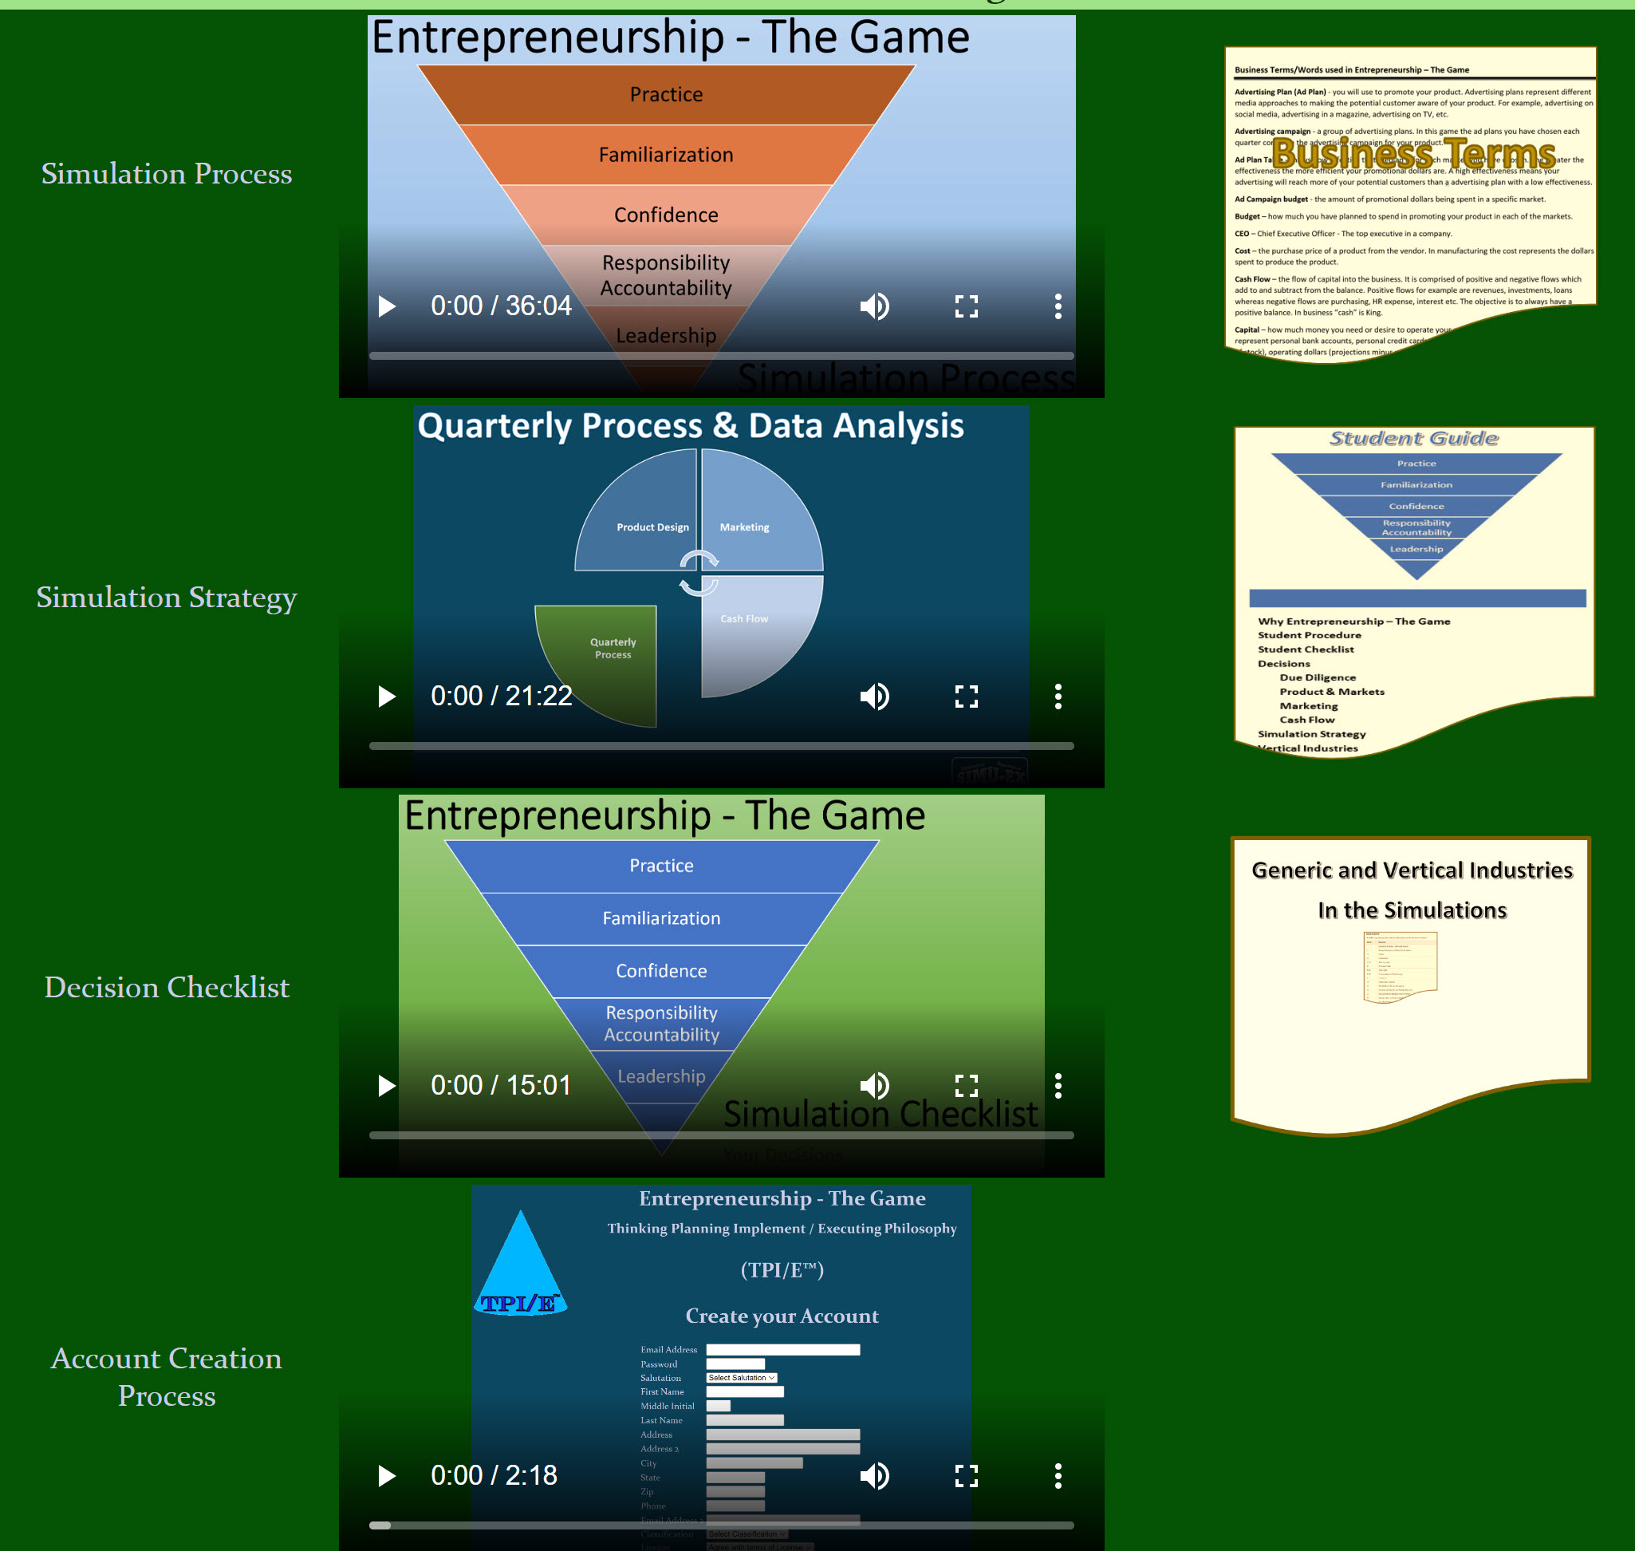
Utilize the Training Tools
Responsibility

